Slide 1
ANN

Slide 2
Neural Networks
Artificial neural networks are among the most powerful learning models. They have the versatility to approximate a wide range of complex functions representing multi-dimensional input-output maps. Neural networks also have inherent adaptability, and can perform robustly even in noisy environments
An Artificial Neural Network (ANN) is an information processing paradigm that is inspired by the way biological nervous systems, such as the brain, process information.
The key element of this paradigm is the novel structure of the information processing system.
It is composed of a large number of highly interconnected simple processing elements (neurons) working in unison to solve specific problems.
ANNs, like people, learn by example. An ANN is configured for a specific application, such as pattern recognition or data classification, through a learning process.
Learning in biological systems involves adjustments to the synaptic connections that exist between the neurons.
This is true of ANNs as well. ANNs can process information at a great speed owing to their highly massive parallelism.

Slide 3
Other advantages include:
1. Adaptive learning: An ability to learn how to do tasks based on the data given for training or initial experience.
2. Self-Organisation: An ANN can create its own organization or representation of the information it receives during learning time.
3. Real Time Operation: ANN computations may be carried out in parallel, and special hardware devices are being designed and manufactured which take advantage of this capability.
4. Fault Tolerance via Redundant Information Coding: Partial destruction of a network leads to the corresponding degradation of performance. However, some network capabilities may be retained even with major network damage.

Slide 4
Artificial Neural Networks
Artificial neural networks are represented by a set of nodes, often arranged in layers, and a set of weighted directed links connecting them.
The nodes are equivalent to neurons, while the links denote synapses. The nodes are the information processing units and the links acts as communicating media.

Slide 5
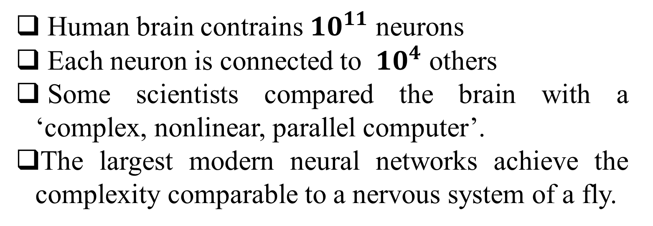
Some Facts
Human brain contrains ${10}^{11}$ neurons
Each neuron is connected to ${10}^{4}$ others
Some scientists compared the brain with a ‘complex, nonlinear, parallel computer’.
The largest modern neural networks achieve the complexity comparable to a nervous system of a fly.

Slide 6
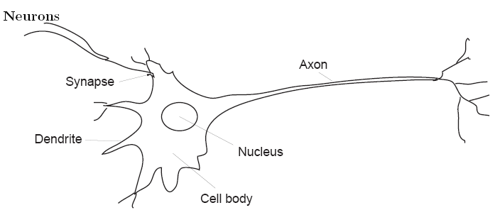
Some Facts

Slide 7
Some Facts
Evidence suggests that neurons receive, analyses and transmit information.
The information in transmitted in a form of electro-chemical signals (pulses).
When a neuron sends the information we say that a neuron ‘fires’.

Slide 8
Excitation and Inhibition
The receptors of a neuron are called synapses, and they are located on many branches, called dendrites.
There are many types of synapses, but roughly they can be divided into
Two classes:
Excitatory a signal received at this synapse ‘encourages’ the neuron to fire
Inhibitory a signal received at this synapse inhibits the neuron (as if asking to ‘shut up’)
The neuron analyses all the signals received at its synapses. If most of them are ‘encouraging’, then the neuron gets ‘excited’ and fires its own message along a single wire, called axon.
The axon may have branches to reach many other neurons

Slide 9
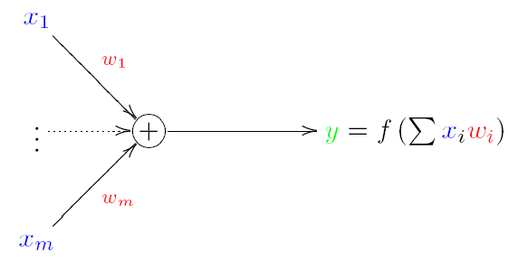

A Model of A Single Neuron
Model of a Single Neuron (Unit)
McCulloch and Pitts (1943) proposed the ‘integrate and fire’ model:

Slide 10

A Model of A Single Neuron
The input values are multiplied by their weights and summed
The output is some function y = f(v) of the weighted sum
Example 1. Let x = (0, 1, 1) and w = (1,−2, 4).
Then v = 1 · 0 − 2 · 1 + 4 · 1 = 2

Slide 11

Activation Function
The output of a neuron (y) is a function of the weighted sum
y = f(v)
This function is often called the activation function.
What function is it and how is it computed?
Linear function:
where parameter a is called bias.
Notice that in this case, a neuron becomes a linear model with bias a being the intercept and the weights,
w1, . . . ,wm, being the slopes.

Slide 12
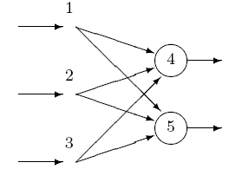
Neural Networks
Feed-Forward Neural Networks
A collection of neurons connected together in a network can be represented by a directed graph:

Slide 13
Neural Networks
Nodes represent the neurons, and arrows represent the links between them.
Each node has its number, and a link connecting two nodes will have a pair of numbers (e.g. (1, 4) connecting nodes 1 and 4).
Networks without cycles (feedback loops) are called a feed-forward networks (or perceptron).

Slide 14
Input and Output Nodes
Input nodes of the network (nodes 1, 2 and 3) are associated with the input variables (x1, . . . , xm). They do not compute anything, but simply pass the values to the processing nodes. Output nodes (4 and 5) are associated with the output variables (y1, . . . , yn).

Slide 15
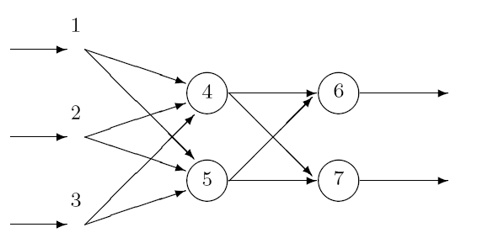
Hidden Nodes and Layers
A neural network may have hidden nodes — they are not connected directly to the environment (‘hidden’ inside the network):
We may organise nodes in layers: input (nodes 1,2 and 3), hidden (4 and 5) and output (6 and 7) layers.
Neural networks can have several hidden layers.

Slide 16

Numbering the Weights
Each jth node in a network has a set of weights wij .

Slide 17
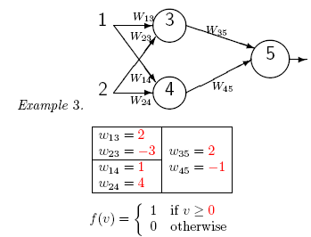
Numbering the Weights
What is the network output, if the inputs are x1 = 1 and x2 = 0?

Slide 18
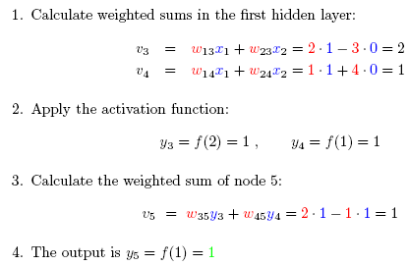
Solution

Slide 19
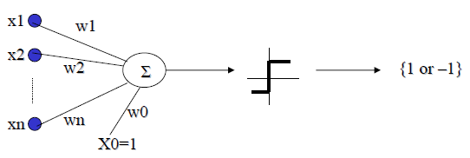

Some Facts
Definition: It’s a step function based on a linear combination of real-valued inputs. If the combination is above a threshold it outputs a 1, otherwise it outputs a –1.
A perceptron draws a hyperplane as the decision boundary over the (n-dimensional) input space.

Slide 20
Perceptron
Definition: It’s a step function based on a linear combination of real-valued inputs. If the combination is above a threshold it outputs a 1, otherwise it outputs a –1.
A perceptron draws a hyperplane as the decision boundary over the (n-dimensional) input space.

Slide 21
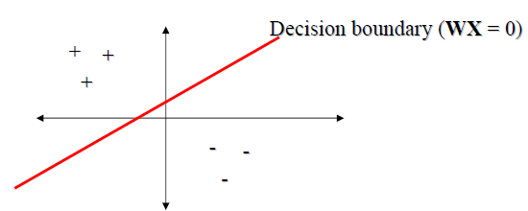
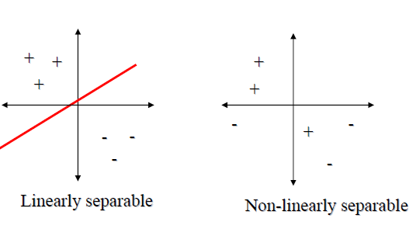
A perceptron can learn only examples that are called “linearly separable”. These are examples that can be perfectly separated by a hyperplane.

Slide 22
Back-Propagation Algorithm
Multi-layered perceptrons can be trained using the back-propagation algorithm described next.
Goal: To learn the weights for all links in an interconnected multilayer network.
We begin by defining our measure of error:
E(W) = ½ Σd Σk (tkd – okd) 2
k varies along the output nodes and d over the training examples.
The idea is to use again a gradient descent over the space of weights to find a global minimum (no guarantee).

Slide 23
Algorithm
1.Create a network with n in input nodes, n hidden internal nodes, and n out output nodes.
2. Initialize all weights to small random numbers.
3. Until error is small do:
For each example X do
• Propagate example X forward through the network
• Propagate errors backward through the network

Slide 24
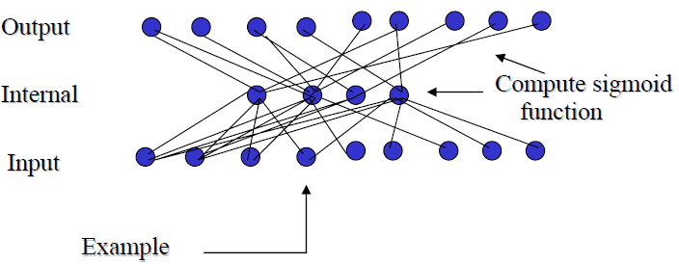
Forward Propagation
Given example X, compute the output of every node until we reach the output nodes:

Slide 25
Backward Propagation
A. For each output node k compute the error:
δk = Ok (1-Ok)(tk – Ok)
B. For each hidden unit h, calculate the error:
δh = Oh (1-Oh) Σk Wkh δk
C. Update each network weight:
C. Wji = Wji + ΔWji
where ΔWji = η δj Xji (Wji and Xji are the input and weight of node i to node j)
A momentum term, depending on the weight value at last iteration, may also be added to the update rule as follows. At iteration n we have the following:
ΔWji (n) = η δj Xji + αΔWji (n)
Where α ( 0 <= α <= 1) is a constant called the momentum.
1. It increases the speed along a local minimum.
2. It increases the speed along flat regions.

Slide 26
Remarks on Back-propagation
1.It implements a gradient descent search over the weight space.
2. It may become trapped in local minima.
3. In practice, it is very effective.
4. How to avoid local minima?
a) Add momentum.
b) Use stochastic gradient descent.
c) Use different networks with different initial values for the weights.

Slide 27
Applications of Neural Networks
Function approximation (modeling)
Pattern classification (analysis of time-series, customer databases, etc).
Object recognition (e.g. character recognition)
Data compression
Security (credit card fraud)

Slide 28
Advantages of Neural Networks
Can be applied to many problems, as long as there is some data.
Can be applied to problems, for which analytical methods do not yet exist
Can be used to model non-linear dependencies.
If there is a pattern, then neural networks should quickly work it out, even if the data is ‘noisy’.
Always gives some answer even when the input information is not complete.
Networks are easy to maintain.

Slide 29
Limitations of Neural Networks
Like with any data-driven models, they cannot be used if there is no or very little data available.
There are many free parameters, such as the number of hidden nodes, the learning rate, minimal error, which may greatly influence the final result.
Not good for arithmetic's and precise calculations.
Neural networks do not provide explanations. If there are many nodes, then there are too many weights that are difficult to interpret (unlike the slopes in linear models, which can be seen as correlations). In some tasks, explanations are crucial (e.g. air traffic control, medical diagnosis).

